Slide 1

Experimental Mechanics
Digital Image Correlation
Janice Dulieu-Barton
janice@soton.ac.uk
Notes:
Please use the dd month yyyy format for the date for example 11 January 2008. The main title can be one or two lines long.

Slide 2
Digital Image Correlation
Aims:
Overview of the technique – quick discussion
Describe equipment set-up
Briefly discuss data processing
Physical factors that affect measurement, speckle, lighting etc.
Identify limitations: spatial versus strain resolution
Case studies

Slide 3
Equipment set-up
Two high resolution CCD cameras mounted on an adjustable rail and a tripod
A computer-camera interface to allow the cameras to be triggered at a user-defined rate
A computer for controlling the DIC measurement procedure and processing the images to calculate deformation

Slide 4
Procedure

Slide 5
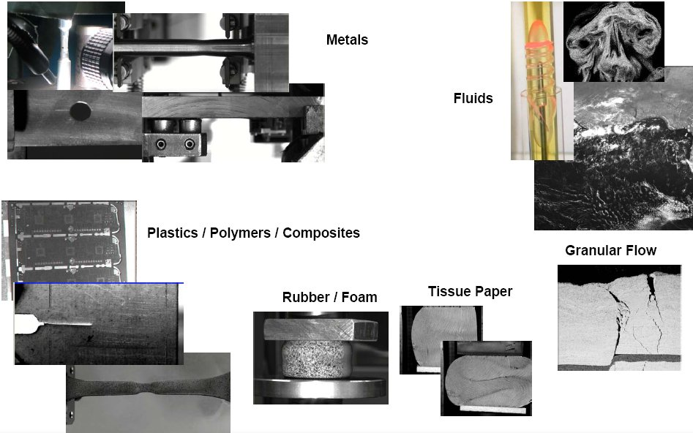
Why do we need DIC
Tests where deformation is too great for strain gauge to measure
Range of materials where strain gauges can’t be applied

Slide 6
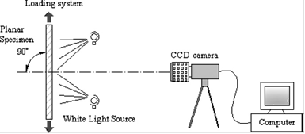
2D single camera DIC

Slide 7
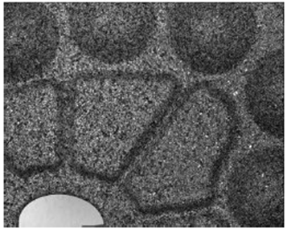
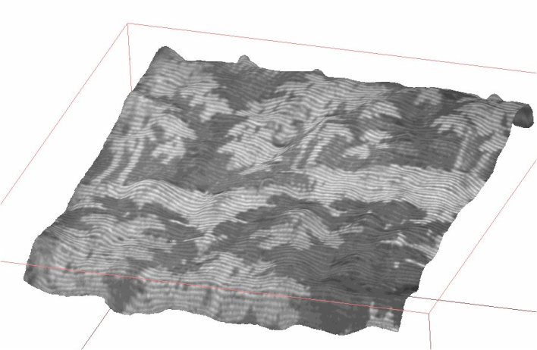
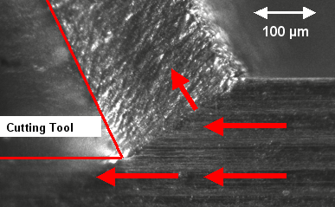
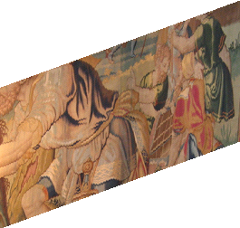
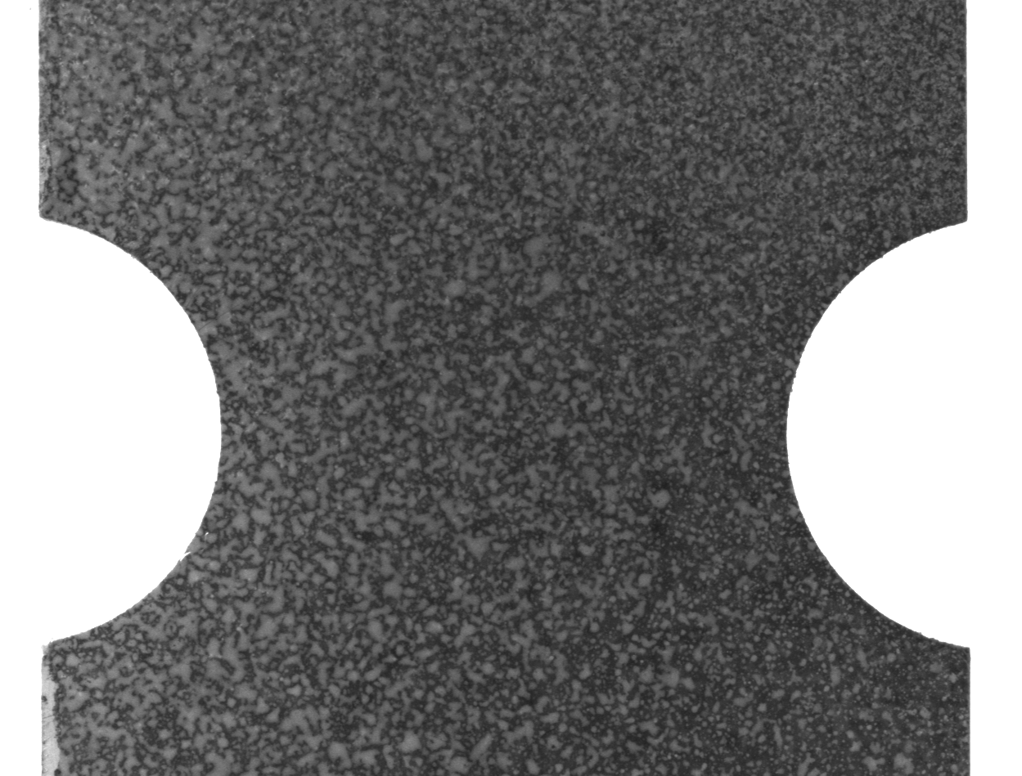
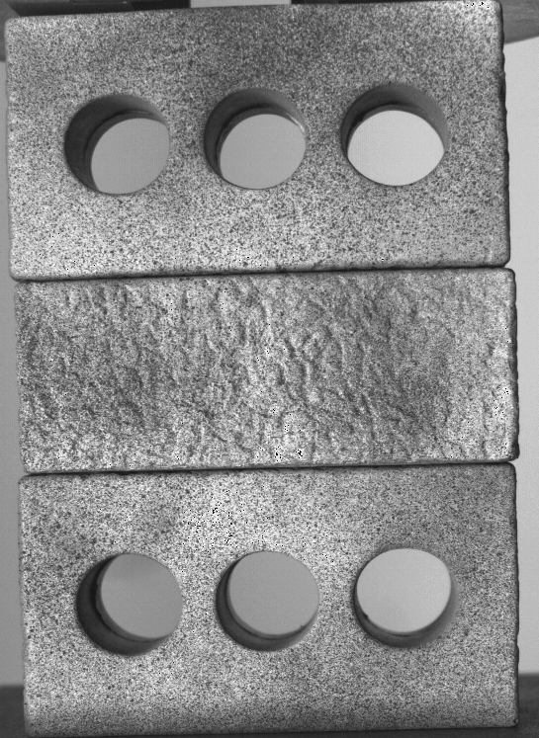
Sample Preparation

Slide 8
Typical Surface Patterns

Slide 9


Basic measurement
Image surface (pattern)
Image discretised into smaller interrogation windows
Calculate displacement of surface pattern within each cell

Slide 10
Cells or facets and step size
Larger cell size = less noise (more points to average over) but looses peak definition – smoothing effect
Smaller cell size better spatial resolution but more noise
Pay off between spatial and strain resolution

Slide 11
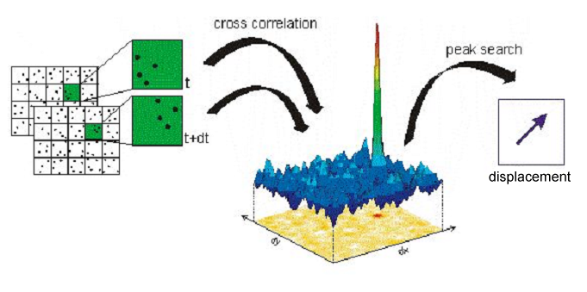
Concept of correlation
Matching the recorded surface pattern within image sub-regions (or “facets”) between the reference condition and loaded condition to determine a map of displacements.

Slide 12
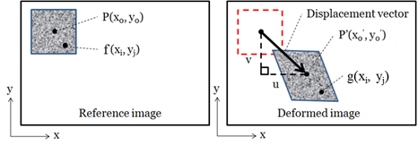

Correlation
Cross-correlation: This generally requires quite large interrogation cells and is sensitive to lighting fluctuations, pattern type and image noise.
Cross-correlation in the Fourier domain: Also requires large interrogation cells but is less sensitive to lighting fluctuations, pattern type and image noise.
Variational (Sum of Squared Differences): Can use smaller interrogation cell sizes and provides a rapid calculation, however is sensitive to lighting fluctuations and pattern type but insensitive to image noise.
The SSD method computes the position of the deformed subset to the nearest pixel accuracy by minimising the result of the following function:

Slide 13
Strain calculation
du and dv obtained by iterating across the displacement vector field and computing the differences between the x-components and y-components of every two adjacent vectors.
The parameters dx and dy correspond to the distance between the centres of each adjacent interrogation cells. In the DaVis software, a central difference algorithm is used to compute the strain values

Slide 14
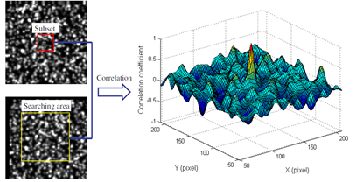
Correlation values across a 150 x 150 pixel search area
In cases where the subset has a low uniqueness, multiple maximum points may occur, increasing the chances of decorrelation.

Slide 15
Optimising the matching algorithm
The pattern is matched best where the differences are minimised, this provides the displacement for that subset
What mathematical function is used to match patterns within subsets?
How is rotation and shear across subsets dealt with
Achieving sub-pixel precision and necessity for image interpolation

Slide 16
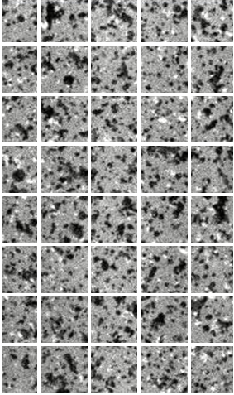
Zero order correlation
Surface pattern image
Correlation plane
The limitation of matching a square subset in the reference image with a square subset in the deformed image is clearly visible – not all features overlap
= Limit of zero order subset shape function
How do we deal with rotation and shear across subsets?
= Subset image deformation (higher order shape functions)

Slide 17
1st order subset deformation
Surface pattern image
Correlation plane
By using a 1st order or affine subset deformation it is possible to achieve a better match between subsets in the reference and deformed image.
Result is still only one displacement vector per subset
How do we quantify the amount of rotation and shear?
= One of the parameters minimised in the shape function or
= Differentiation between neighbouring subset displacements

Slide 18


Grey scale image interpolation
Surface pattern image
Each small square is a pixel
We need to deform the subset in the second image to match that in the ref image
Requires sub-pixel image interpolation to re-build the deformed subset image content

Slide 19
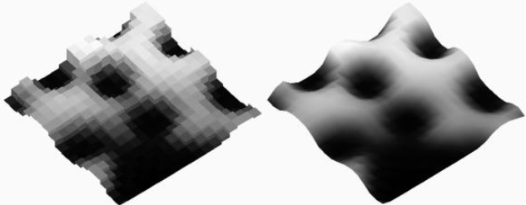
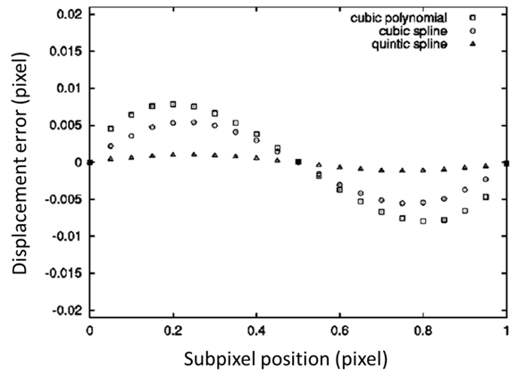
Grey scale interpolation
Raw
Interpolated
How we reconstruct subset image content which has been displaced /deformed (by non-integer pixel values)
Fast and Medium mode |  | Accurate mode
Bilinear |  | 6th Order Spline
For small stains (<1%) Can lead to banding (pixel locking) in the strain field. Similar to pixel locking due to speckle size being too small: |  | Better interpolation with less susceptibility to pixel locking

Slide 20
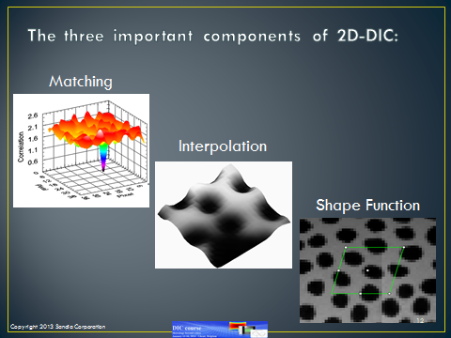
Processing space

Slide 21
Measurement space
Loading
Specimen
Sensor
Test Machine
Misalignment
Out of plane displacement
Vibrations
Calibration
Speckle
Pattern
Size
Shape
Contrast
Illumination
Camera
Resolution
Dynamic range
Noise
Lens

Slide 22

2D DIC - out-of-plane displacement
CCD
Z
ΔΖ
Out of plane displacement results in artificial tensile/compressive strain
Out of plane displacement of 1 mm at a working distance of d=1m results in an artificial strain of 10⁻³ = 0.1% = 1000 µStrain

Slide 23
Camera misalignment
For a 2D DIC system, a camera that is not aligned perpendicularly to the surface under investigation creates a uniform in-plane strain after correlation due to difference in magnification across the width.
For small angles this effect is small.
Since a camera alignment within 5° is easily achievable, camera misalignment does not cause significant error in 2D DIC
For Single Camera DIC, camera must be perpendicular to surface

Slide 24
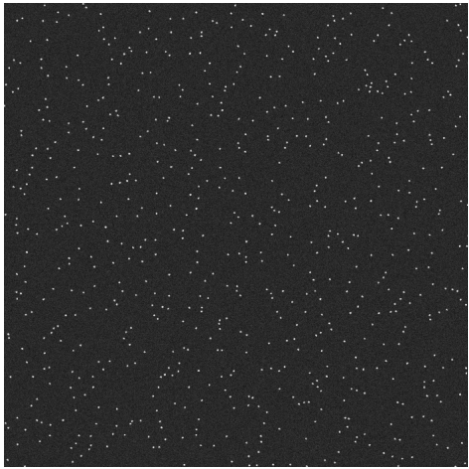
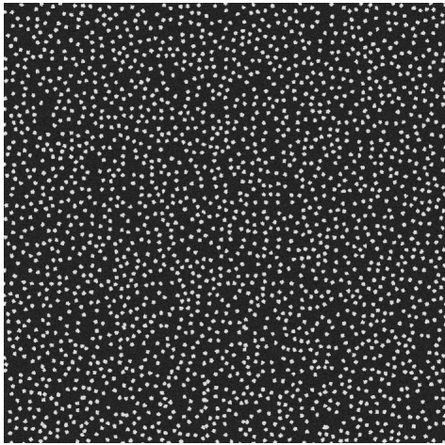
What is the best speckle pattern?
Generated pattern with 6 speckles per subset, and a speckle radius of 3 pixels
Generated pattern with 18 speckles per subset, and a speckle radius of 8 pixels

Slide 25
Scatter in strain data

Slide 26
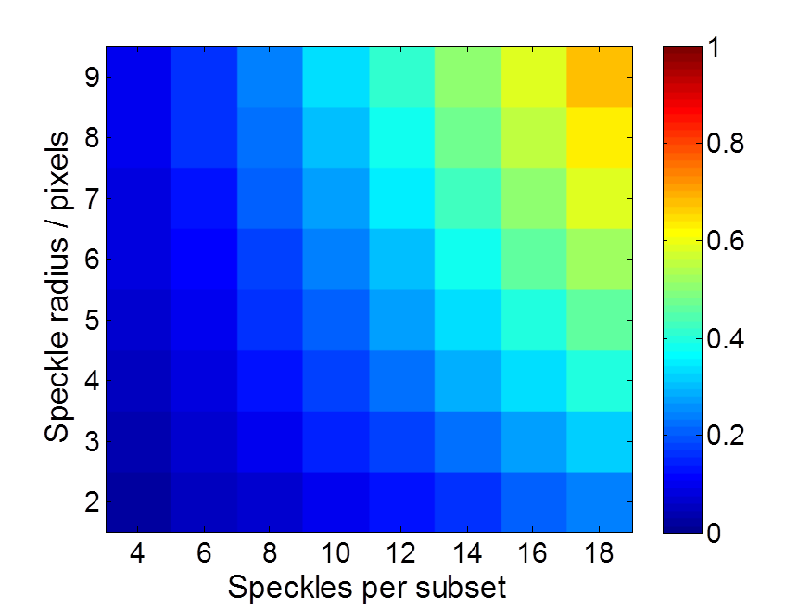
Image assessment
Global image assessment is to apply a parameter from information theory known as Shannon entropy
A measure of the information content of an image that is used for evaluating the randomness, or texture, of a form or pattern.
An image with high entropy requires a large number of ‘bits’ to create an adequate representation of the form in a digital image.
Hence a pattern with a high Shannon entropy value indicates a high level of texture, or broadness in the grey scale distribution of the image, both of which are beneficial for maximising the correlation function peak when a correct match has been found. The Shannon entropy is defined as:

Slide 27
Speckle pattern assessment
Speckle pattern
Edge detection
Binary speckle pattern

Slide 28
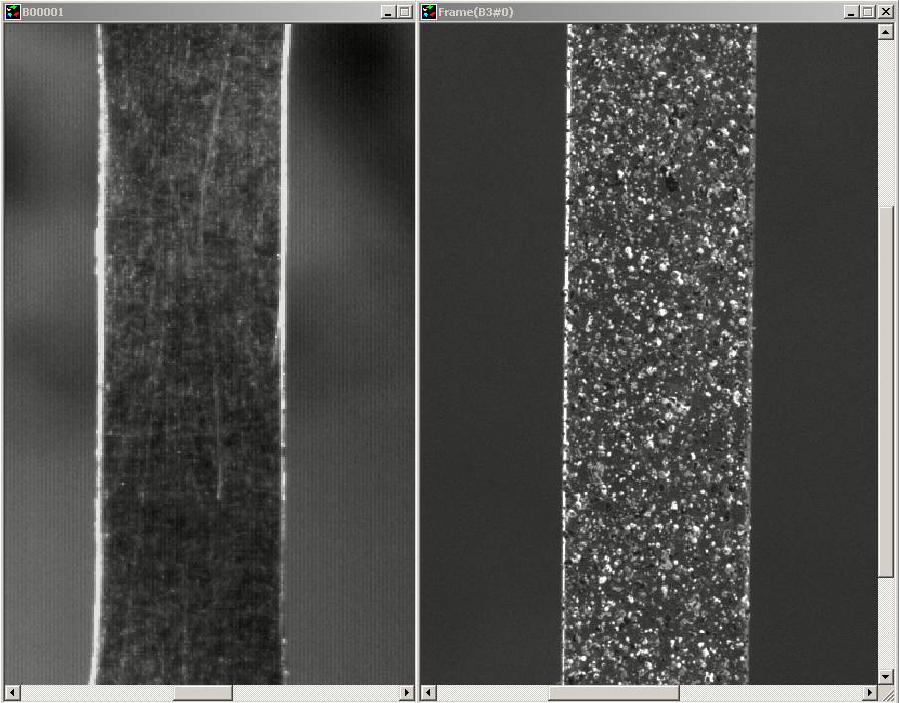
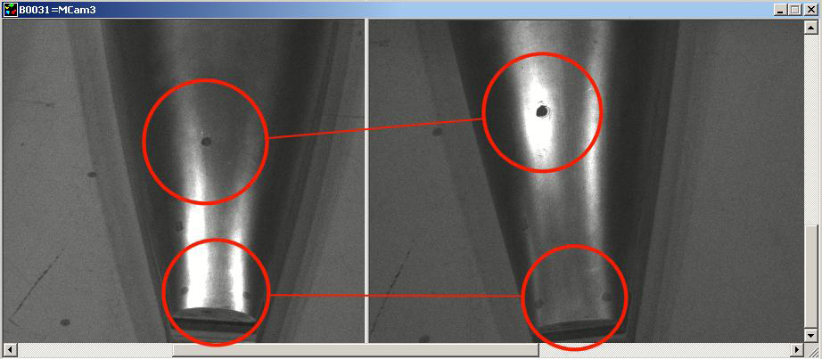
Contrast and Reflections
In this example, the sample on the left has very low contrast in the surface pattern. The image on the right shows a sample with more suitable pattern contrast
Here the shiny metal surface of the probe reflects the light of the illumination source. There are reflections on different places as the probe is deforming making it very difficult to track the actual probe and its surface feature movements.

Slide 29






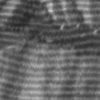
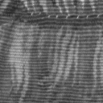
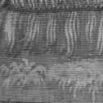
Camera Resolution/Magnification
Cell size (pixels)
32x32
64x64
128x128
Increasing image resolution (pix/mm)
inc cam resn OR magnification
Increasing precision

Slide 30
Scaling and Calibration
Determination of Magnification factor
  Relates to dimension on specimen to a corresponding dimension on the image plane of camera (pix/mm)
Lens Distortion
  Lens with long focal lengths can be employed to minimize radial lens distortion
Viewing through optical surfaces
  Can be corrected through appropriate calibration
Notes:
30

Slide 31
Summary
Hardware Set-up
Camera and lighting set-up Good and bad practices
What makes a good pattern How to apply the speckle
Appropriate mode to use
Importance of resolution Timing, image sequences, frame rate, synchronisation
The construction of DIC algorithms Interpolation, shape function, matching and correlation
Filtering and post-processing displacement data Strain calculation from displacements
Displaying data Exporting data and extracting values
Sample Preparation
Calibration
Imaging
Calculate Displacements
Extract Strain Data
Result

Slide 32
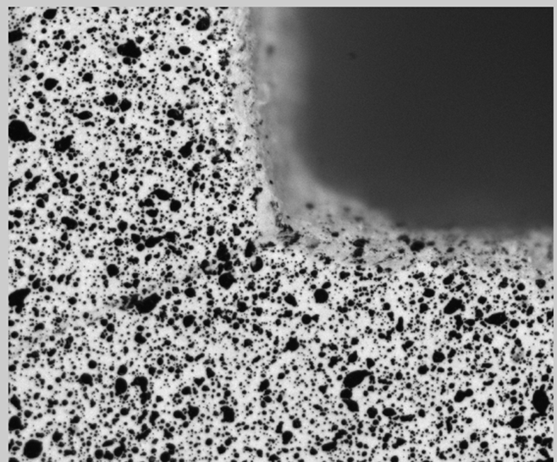
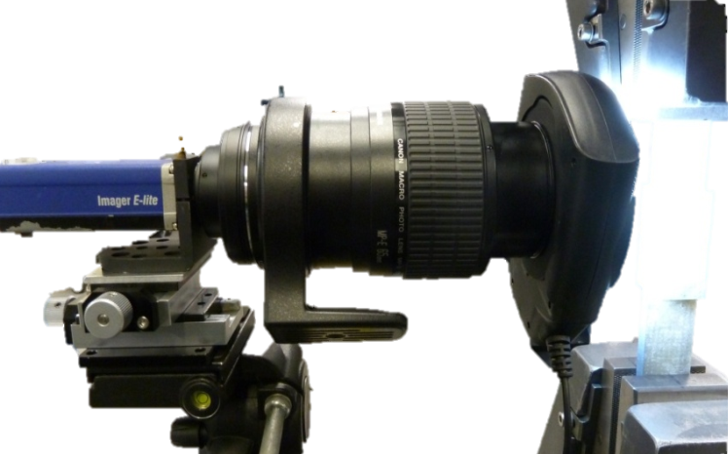
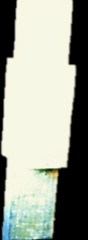
Case study of bonded joint
Applied load
Increasing use of composite materials in large complex structures
The discontinuous nature of adhesively bonded joints necessitates through-thickness load transfer between components
Composite material weak in the through-thickness plane – leasing to the initiation of damage and failure
A Glass fibre double butt strap joint (DBSJ) to be used for testing [CSM₃,0₅,CSM₂]_{s}
Areas of macro scale analysis
Root of discontinuity
Strap length
Overlap length
LaVision E-Lite 5Mp camera
LED Ring light
725 pixel / mm
Outer adherend (strap)
Adhesive
y
Inner adherend
2.6 mm
z
x
Applied load
X-Y-θ stage
Canon MP-e65 lens
3.1mm

Slide 33
15kN
Inner adherend
Inner adherend
Inner adherend
Inner adherend
Inner adherend
Root of discontinuity
Inner adherend
Root of discontinuity
Root of discontinuity
Root of discontinuity
Root of discontinuity
Root of discontinuity
Outer adherend
Outer adherend
Outer adherend
Outer adherend
Outer adherend
Outer adherend
Strain
Strain
Strain
Strain
Strain
Strain
Adhesive
Adhesive
Adhesive
CSM
CSM
CSM
CSM
CSM
CSM
Axial strain distribution shows load transfer between inner and outer adherends
Large peel strain concentration in outer adherend due to eccentricity of the load path
High shear strain in adhesive layer – shear across adhesive primary load transfer mechanism
Peel and shear strains concentrated at the interface between the materials identifying some coupling of the response due to the through-thickness load transfer in the structure

Slide 34
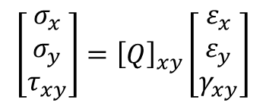
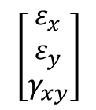
17kN
Inner adherend
Root of discontinuity
Inner adherend
Inner adherend
Root of discontinuity
Root of discontinuity
Outer adherend
Outer adherend
Outer adherend
Strain
Strain
Strain
Adhesive
Adhesive
Adhesive
CSM
CSM
CSM
CSM
CSM
CSM
Indication of damage occurring within joint identifiable due to change in the axial strain distribution
Peel and shear strains also become very large at the interface between the outer adherend and the adhesive layer
Component strains provide good quantitative information but do not provide an insight into the development of damage – analysis of the stresses required
$$\left[\begin{matrix}ε_{x} \\ ε_{y} \\ γ_{xy}\end{matrix}\right]$$
$$\left[\begin{matrix}σ_{x} \\ σ_{y} \\ τ_{xy}\end{matrix}\right]={\left[Q\right]}_{xy}\left[\begin{matrix}ε_{x} \\ ε_{y} \\ γ_{xy}\end{matrix}\right]$$

Slide 35
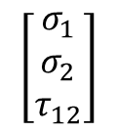
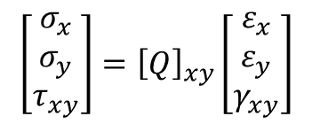
15kN
Inner adherend
Root of discontinuity
Inner adherend
Root of discontinuity
Inner adherend
Root of discontinuity
Outer adherend
Outer adherend
Outer adherend
MPa
MPa
MPa
CSM
Adhesive
CSM
CSM
Adhesive
CSM
CSM
Adhesive
CSM
High shear stress along material interfaces with the adhesive layer
Significant localised peel stress concentrations at the root of the discontinuity
Component stresses closely agree with the component strain distributions
Analysis of the principal stresses required to evaluate damage
$$\left[\begin{matrix}σ_{x} \\ σ_{y} \\ τ_{xy}\end{matrix}\right]={\left[Q\right]}_{xy}\left[\begin{matrix}ε_{x} \\ ε_{y} \\ γ_{xy}\end{matrix}\right]$$
Transformation using Mohr’s circle
$$\left[\begin{matrix}σ_{1} \\ σ_{2} \\ τ_{12}\end{matrix}\right]$$

Slide 36
15kN
Inner adherend
Root of discontinuity
Inner adherend
Root of discontinuity
Inner adherend
Root of discontinuity
Outer adherend
Outer adherend
Outer adherend
MPa
MPa
MPa
CSM
Adhesive
CSM
CSM
Adhesive
CSM
CSM
Adhesive
CSM
Indication of damage occurring within joint identifiable due to change in the axial strain distribution
Peel and shear strains also become very large at the interface between the outer adherend and the adhesive layer

Slide 37
16kN
σ₁
Inner adherend
Root of discontinuity
Outer adherend
MPa
CSM
Adhesive
CSM
At 16 kN maximum principal stress becomes very large at the interface between the adhesive and outer adherend
Corresponds to the first visual indications of damage on the surface of the joint
Damage not identified from the DIC data as peel and shear strains very high which mask the identification of the damage on first inspection

Slide 38
Correlate over multiple images
22 images from the static test were combined in all 121 permutations, and the average of all the resulting strain fields was used.
Single strain field
Average of 5 strain fields
Average of 25 strain fields
Average of 121 strain fields

